Slide 1
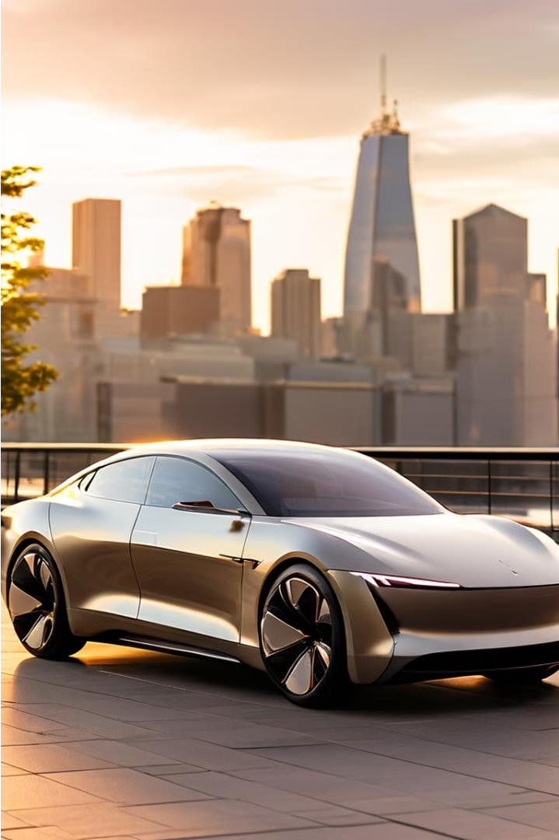
Electric Vehicles: A Closer Look
Electric Vehicle Analysis:
Driving Towards a Sustainable Future
SS
by Saksham Sharma

Slide 2
Contents:
Electric Vehicle Lineup
Analytics
VIN, Make, Model 2020+ Model Year Tesla Vehicles
Advanced Electric Vehicle Analytics
Model Length
Highest Electric Range High-End Vehicles MSRP Ranking
Electric Vehicle Statistics
Total Electric Vehicles Leaf Model’s
Total Electric Vehicles Count
Average Electric Range
Electric Vehicle Trends
Yearly Registrations MSRP Updates
Regional Pricing
SS
Top 5 Highest MSRP
Matching Electric Vehicles
Same Make, Model Year Electric Vehicle Counts by Make Electric Range Categories
Exploring Electric Vehicle Differences
EV Pair's by City

Slide 3
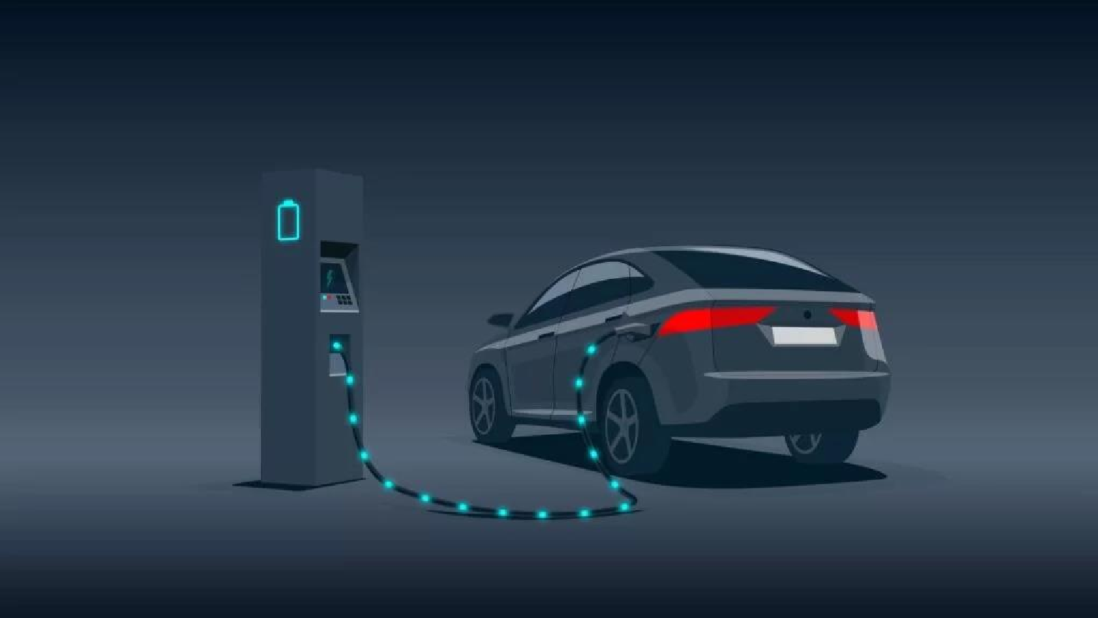
OBJECTIVE :
Provide insights and findings based on the data analysis.
Translate raw data into visual formats for easier interpretation.
Aid stakeholders in making informed decisions.
Assess various performance indicators related to electric vehicles.
Discuss key findings and insights derived from the data.
SS

Slide 4
SCOPE :
Provide insights and findings based on the data analysis.
Translate raw data into visual formats for easier interpretation.
Aid stakeholders in making informed decisions.
Assess various performance indicators related to electric vehicles.
Discuss key findings and insights derived from the data.
SS

Slide 5
TOOLS AND TECHNOLOGIES:
SQL Database : To store query and data
Data Visualization Tools : Such as Excel, embedded chart features in PowerPoint to create visuals and MySQL Workbench
Presentation Software: Microsoft PowerPoint for creating the slides.
SS

Slide 6
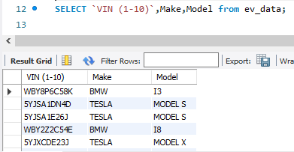
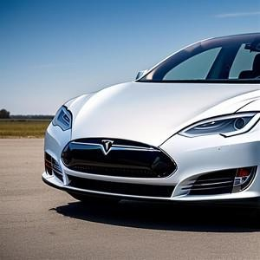
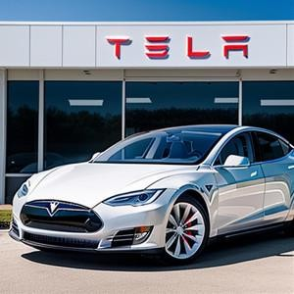
Electric Vehicle Lineup
1
VIN, Make, Model
List all electric vehicles with their unique identifiers and model details.
Our comprehensive database includes detailed information on a wide range of electric vehicles, including their unique VIN (1-10), make, and model. This allows us to provide a complete overview of the available EV options for our customers.

Slide 7
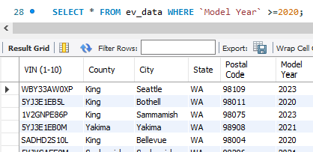

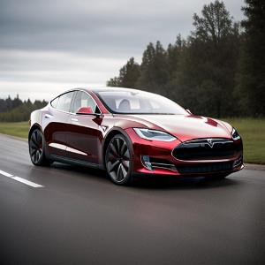
Electric Vehicle Lineup
2
2020+ Model Year
Showcase the latest electric vehicle models from the past few years.
To ensure we offer the most up-to-date and advanced electric vehicles, our query focuses on models from 2020 and later. This allows us to showcase the latest technological advancements and features that these cutting-edge EVs have to offer.

Slide 8
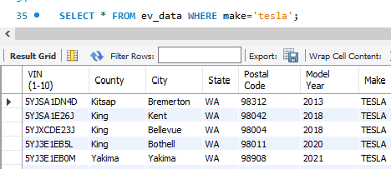

Electric Vehicle Lineup
3
Tesla Vehicles
Highlight the electric vehicles manufactured by the industry leader, Tesla.
As a leader in the EV market, we are proud to showcase the electric vehicles manufactured by Tesla. These innovative and high- performance models have set the standard for the industry and continue to captivate drivers with their sleek designs and impressive capabilities.

Slide 9

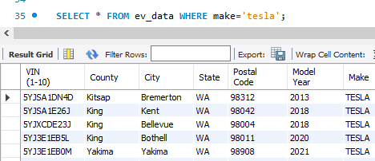
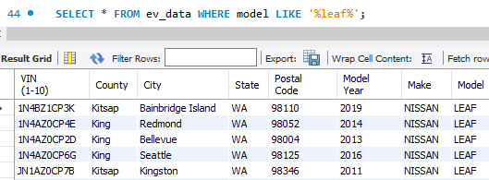

Electric Vehicle Statistics
4
Total Electric Vehicles Leaf Model’s
Display the vehicles of Leaf Model’s
For those interested in the Nissan Leaf, our query allows you to easily find all electric vehicles where the model name contains the word "Leaf." This provides a focused search for this popular and eco-friendly EV option.

Slide 10
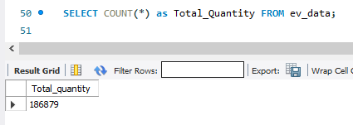
Electric Vehicle Statistics
5
Total Electric Vehicles Count
Provide the total quantity of vehicles from the dataset
To give you a comprehensive understanding of the EV market, we've included a query that counts the total number of electric vehicles in our database. This information can help you gauge the scale and growth of this rapidly evolving industry.

Slide 11
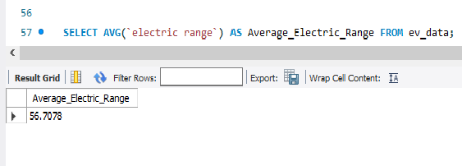
Electric Vehicle Statistics
6
Average Electric Range
Provide the overall count of electric vehicles in the dataset.
Knowing the average electric range of the vehicles in our database is crucial for understanding the capabilities and performance of these eco-friendly cars. Our query provides this valuable data point to help you make informed decisions.

Slide 12
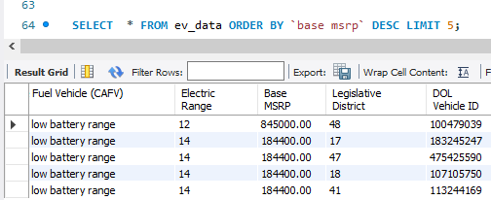
Electric Vehicle Statistics
7
Top 5 Highest MSRP
Identify the electric vehicles with the highest base prices.
For those seeking the ultimate in luxury and performance, our query showcases the top 5 electric vehicles with the highest base MSRP, sorted in descending order. This allows you to explore the most premium and high-end EV options available.

Slide 13

Matching Electric Vehicles
*
Same Make, Model Year
Find electric vehicle pairs with identical make and model year.
*
Electric Vehicle Counts by Make
Analyze the distribution of electric vehicles by manufacturer.
*
Electric Range Categories
Classify electric vehicles based on their battery range capabilities.

Slide 14
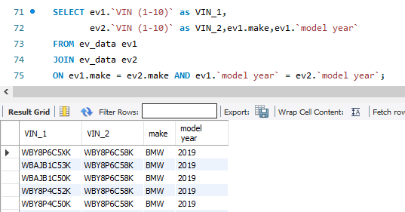
Matching Electric Vehicles
8
Same Make, Model Year
Find electric vehicle pairs with identical make and model year.
Our database also allows you to identify electric vehicles that share the same make and model year. This information can be useful for comparing and contrasting similar EV models, as well as for finding potential matches or alternatives.

Slide 15
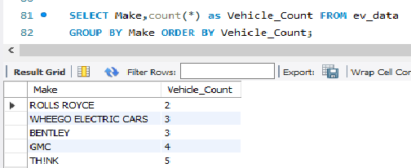
Matching Electric Vehicles
9
Electric Vehicle Counts by Make
Analyze the distribution of electric vehicles by manufacturer.
To provide a deeper understanding of the EV market, our query breaks down the total number of electric vehicles by make. This data can help you identify the most popular and dominant brands in the industry, as well as emerging players.

Slide 16
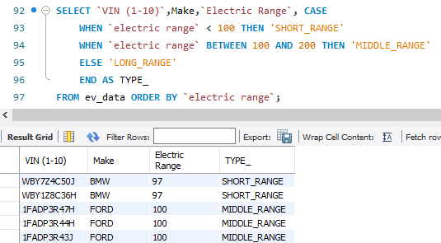
Matching Electric Vehicles
10
Electric Range Categories
Classify electric vehicles based on their battery range capabilities.
Short Range
Electric vehicles with a range less than 100 miles are categorized as "Short Range." These models may be suitable for urban commuters or those with access to frequent charging opportunities.
Long Range
Electric vehicles with a range exceeding 200 miles are categorized as "Long Range." These high-performance models provide the freedom and flexibility for longer-distance travel.
Medium Range
Electric vehicles with a range between 100 and 200 miles are categorized as "Medium Range." These models offer a balance of practicality and convenience for daily driving needs.

Slide 17
Advanced Electric Vehicle Analytics
Model Length
Calculate the length of each electric vehicle
model name.
Highest Electric Range
Identify the electric vehicle with the maximum
battery range.
High-End Vehicles
View a curated list of electric vehicles with a high
base MSRP.
MSRP Ranking
Rank electric vehicles within each model year by
base MSRP.

Slide 18
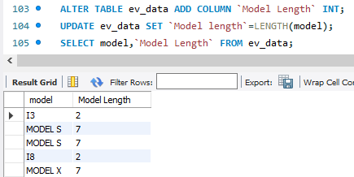
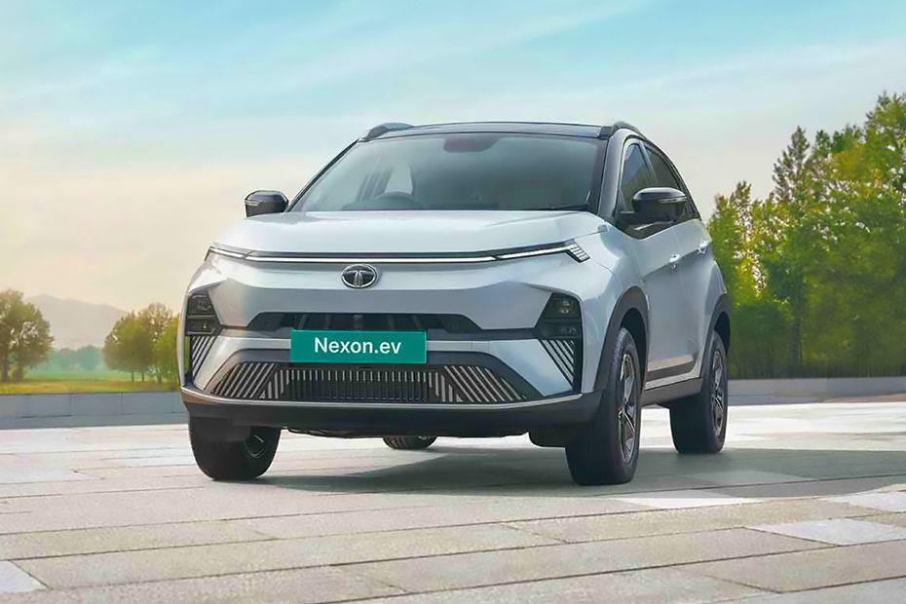
Advanced Electric Vehicle Analytics
11
Model Length
Calculate the length of each electric vehicle model name.
Our database now includes a new column, "Model_Length," which calculates the length of each model name. This can be a useful data point for various analyses and comparisons.

Slide 19
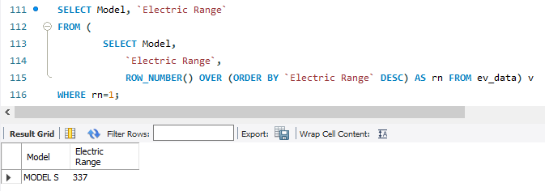
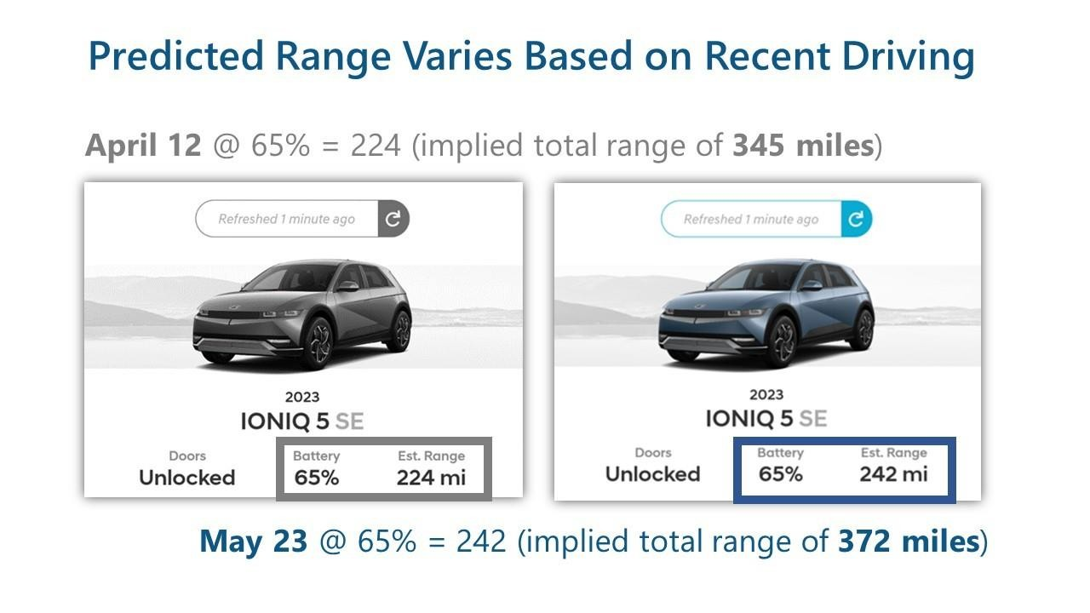
Advanced Electric Vehicle Analytics
12
Highest Electric Range
Identify the electric vehicle with the maximum battery range.
Using advanced functions, we've identified the electric vehicle with the highest electric range in our database, providing you with the ultimate in long-distance driving capabilities.

Slide 20
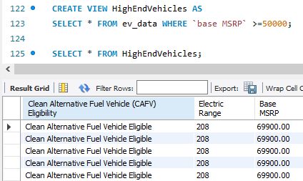
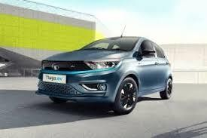
Advanced Electric Vehicle Analytics
13
High-End Vehicles
View a curated list of electric vehicles with a high base MSRP.
Our "HighEndVehicles" view showcases electric vehicles with a base MSRP of $50,000 or higher, catering to those seeking the most premium and luxurious EV options.

Slide 21
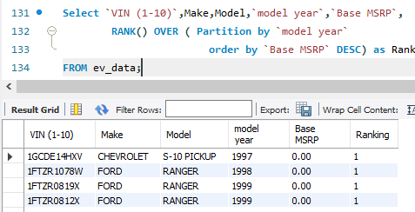

Advanced Electric Vehicle Analytics
14
MSRP Ranking
Rank electric vehicles within each model year by base MSRP.
Using window functions, we can now rank electric vehicles based on their base MSRP within each model year, providing a more nuanced understanding of pricing trends and market positioning.

Slide 22



Electric Vehicle Trends
Yearly Registrations
MSRP Updates
Regional Pricing
Analyze the cumulative growth of electric vehicle registrations over time.
Implement a process to update the base MSRP for individual vehicles.
Identify the county with the highest average electric vehicle pricing.

Slide 23

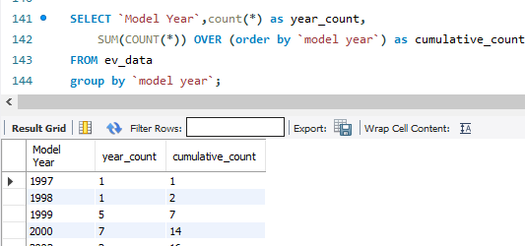
Electric Vehicle Trends
15
Yearly Registrations
Analyze the cumulative growth of
electric vehicle registrations over time.
Our query tracks the cumulative count of electric vehicles registered each year, sorted by model year, giving you a comprehensive view of the industry's growth and adoption over time.

Slide 24
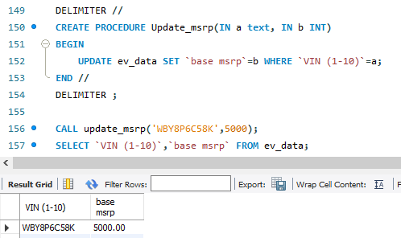
Electric Vehicle Trends
16
MSRP Updates
Implement a process to update
the base MSRP for individual vehicles.
With our stored procedure, you can easily update the base MSRP of any electric vehicle in our database by providing the VIN (1- 10) and the new MSRP value, ensuring your data remains up-to- date and accurate.

Slide 25
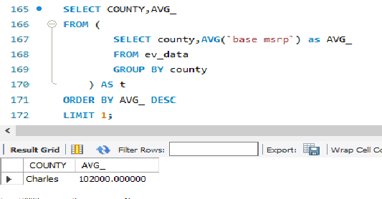
Electric Vehicle Trends
17
Regional Pricing
Identify the county with the
highest average electric vehicle pricing.
Our advanced query using subqueries and aggregate functions has identified the county with the highest average base MSRP for electric vehicles, providing valuable insights into regional pricing trends and market dynamics.

Slide 26
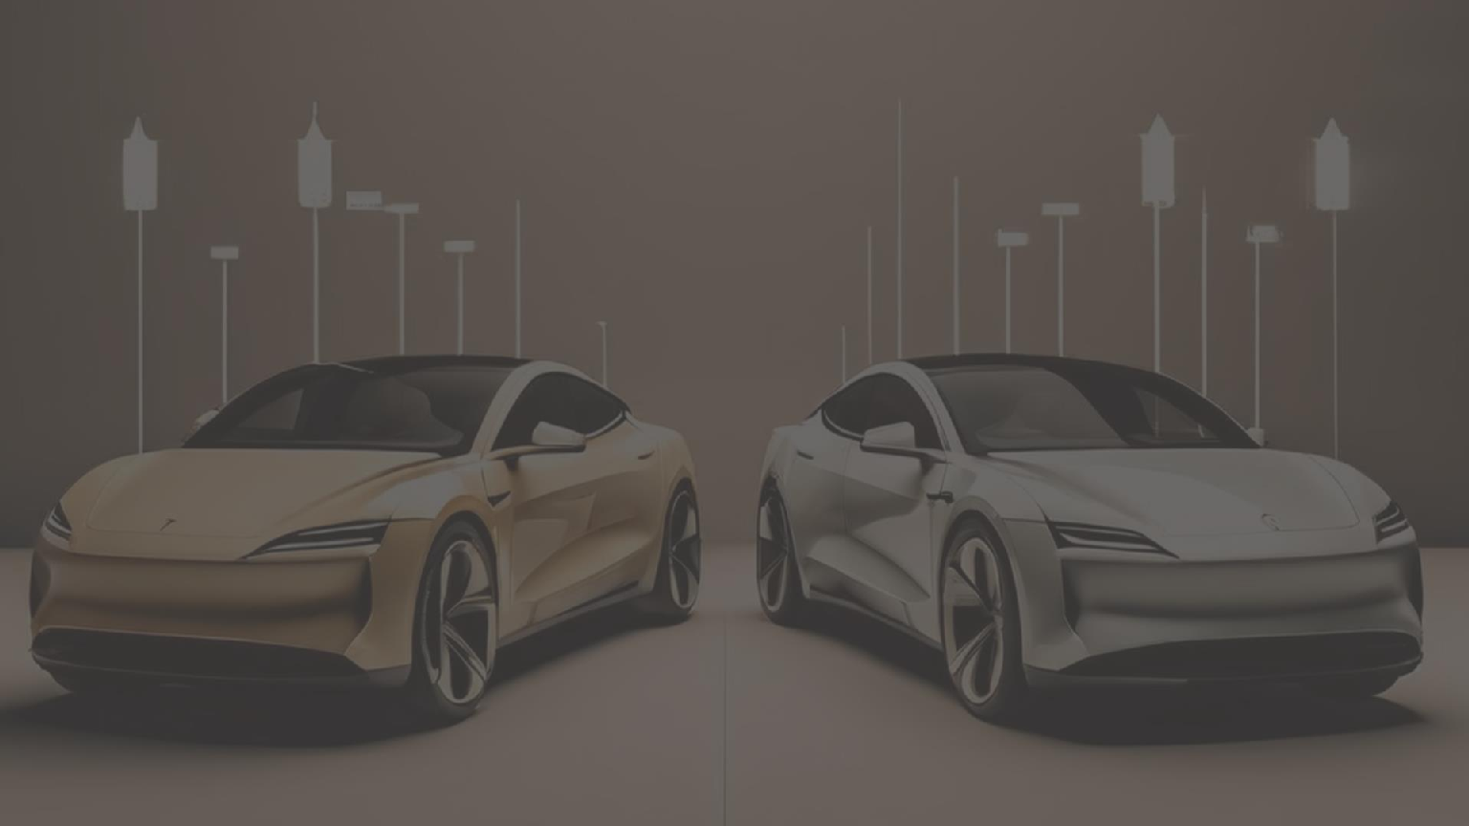

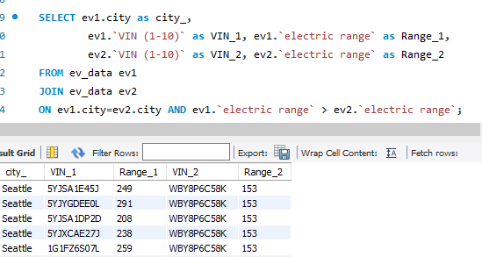
Exploring Electric Vehicle Differences
EV Pairs’s by City
We've also identified pairs of electric vehicles from the same city where one vehicle has a longer electric range than the other, offering a unique perspective on the diversity of EV options within local markets.

Slide 27
The Future of Electric Vehicles
Advancing Technology
Expanding Charging
Infrastructure
Evolving Regulations
Improved battery performance
Increased public charging
stations
Incentives and policies
Autonomous driving features
Faster charging times
Environmental impact standards

Slide 28
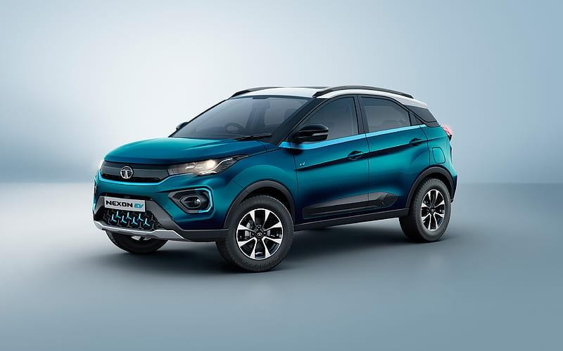
CONCLUSION AND FUTURE WORK
Key Findings :
Sales Trends
Customer Demographic
Recommendations :
Should Expand Charging Network
Data Monitoring
Impact on Decision Making
Strategic Planning
Customer Experience Should Be Added

Slide 29
THANK - YOU

